Slide 1
Long-term Outcomes Following Cytoreductive Surgery and Heated Intraperitoneal Chemotherapy at Waikato
Mosese Karalus, Jasen Ly, Linus Wu, Ralph van Dalen, Simione Lolohea
Notes:
(My name is Mosese Karalus and my presentation is an evaluation of long term outcomes following cytoreductive surgery and heated intraperitoneal chemotherapy)
Imagine you’re in a surgeons office, they’ve found a cancer and it’s spread around your abdomen. They say it’s incurable.
Not so long ago, this was the experience of patients with peritoneal surface malignancy.

Slide 2
`
Historically, palliative diagnosis
Pseudomyxoma 5-year survival without surgery : 15%
Cytoreductive surgery with heated intraperitoneal chemotherapy (CRS with HIPEC)
High morbidity, favourable survival data
Morbidity: 40.9% (Basingstoke, 2014)
5 year survival 84% (Basingstoke, 2014)
Standard of care for pseudomyxoma peritonei (PMP)
Indications expanded to include peritoneal surface malignancy of other primary
Introduction.
Notes:
Historically, peritoneal surface malignancy has been a palliative diagnosis;
In pseudomyxoma peritonei where 5 year survival without surgery was 15% and was otherwise treated with debulking procedures.
This has changed since the introduction of cytoreductive surgery with heated intraperitoneal chemotherapy or CRS with HIPEC, which is the standard of care for PMP. It is a surgical technique with high morbidity, but clear survival benefit in comparison to traditional debulking surgeries. This has lead to it’s indications expanding to include other peritoneal surface malignancies of other primary aetiology

Slide 3
`
CRS with HIPEC introduced in Waikato in 2008
Offered at Waikato (public), and, Braemar (private) hospitals, in Hamilton
Four colorectal surgeons
Recently, we published study to explore short-term outcomes for CRS with HIPEC in NZMJ
(Ly et. al. 2017)
Notes:
At Waikato CRS with HIPEC was introduced in 2008, and is performed by four surgeons in Waikato and Braemar Hospitals in Hamilton
Recently, we published short term outcomes following CRS with HIPEC

Slide 4
`
To evaluate operative and long-term outcomes for the first 100 CRS with HIPEC operations at Waikato
Aim.
Notes:
This is a follow up to this study, to evaluate our operative and long-term outcomes

Slide 5
`
Retrospective analysis
Prospective database
Study period: 2008-2017
Sources:
paper and electronic records
treating and referring hospital records
Births, deaths & marriages
Standard Sugarbaker technique with HIPEC
Method.
Notes:
-Our study is a retrospective analysis of a prospectively maintained database of patients
-The study population reached capacity at mid 2017, from it’s inception in 2008.
-We obtained data from paper & electronic records from surgeons private rooms, and both referring and treating hospitals via medical records
-Mortality data was obtained through hospitals, birth deaths and marriages databases.
-And surgeries were all carried out using techniques described by sugarbaker

Slide 6
`
Referral Source by Regions
Waikato | 27
Auckland | 22
Canterbury South Canterbury Nelson | 13
Southern | 12
Northland | 7
Lakes BOPDHB | 7
Capital & Coast Whanganui Midcentral | 7
Hawkes Bay Tairawhiti | 3
Taranaki | 2
Results.
Notes:
We receive referrals from all regions around the country, with a predominance of referrals from the north island
**Question re: why predominantly Waikato patients.
In the initial years, Waikato was not a national provider for the surgery, hence not funded for and less widely known as an available resource. Our experience now is that referrals across the board meet expectation for population density.
The predominance of patients from our DHB stems from colorectal MDM coordinating the care of appendiceal/ colorectal/ peritoneal cancer referrals directly.
We assume that recieving referrals from surgeons, oncologists, gynaecologists and in the rare situation GPs, who have their own MDTs in their DHB, contributes to less referrals.
due to:
-initial reduced awareness of the available resource
-increased gatekeeping
-peritoneal malignancy of other aetiologies not offered referral

Slide 7
127
Operations
27
Palliative Debulking
100
CRS with HIPEC Surgeries
(92 patients)
`
Demographic Data
Age | 55 (6.3)
Sex | Female 66%
BMI | 29 (6.3)
Ethnicity | NZ European 75% Maori 13% Pacific 10% Other 2%
Re-do operations | 10
Median Follow-up Time: 24m
Waikato
69
Braemar
31
Notes:
-127 cytoreductive surgeries were performed, with 27 of these converted to palliative debulking due to overwhelming disease
-Leaving 100 CRS with HIPEC surgeries in 92 patients.
-10 of our cases were repeat operations, with 2 of these patients had their prior surgeries in Australia.
-69 and 31 operations were completed in Waikato and Braemar hospitals respectively.
-Our cohort was on average, in their middle age, predominantly female, overweight, and NZ European.
{( 2 patients of the 27 shortly after surgery; one jahovas witness who declined blood products, died of anaemia; one with significant haemorrhage, who post-operatively developed multiorgan failure and unfortunatey, did not recover. )}

Slide 8
`
Intraoperative data |  | International Literature: (Basingstoke)
Peritoneal Carcinomatosis Index (PCI) | 18.9 | (not available)
Completeness of Cytoreduction Score (CCR) | *CCR 0-1: 77% | *CCR 0-1: 68%
Operative Time | 8.5 Hours | 10.5 hours
Intraoperative RBC transfusion | 4.1 | 4.9
* n: 127; Inclusive of debulking surgery patients
Notes:
-The average peritoneal carcinomatosis index or PCI score was 18.9
-Our completeness of cytoreduction score was 0-1 in 77% of patients; this number includes
-on average our operations took 8.5 hours
-when used, the average use of RBCs was 4.1 and similarly
For supplementary slides:
-Add number of visceral resections.
peritoneal carcinomatosis index or PCI, is used to objectively measure tumour burden, dividing the abdomen into 14 areas, each with a score between 0-3, hence a maximum score 39
The mean PCI 18.9

Slide 9
`
Histological Subtypes
Appendiceal | 75
Colorectal | 13
Other: | 12
Neuroendocrine | 4
Mesothelioma | 4
Ovarian | 3
Gastric | 1
Notes:
Operative histology returned 75 patients with mucinous appendiceal carcinoma with pseudomyxoma peritonei or PMP
13 patients had colorectal cancer and 12 of other primary malignant aetiologies.
Nb proportion of PMP
Iversen et al HGMCP- 13.8%

Slide 10
`
PMP by Peritoneal Surface Oncology International (PSOGI) Classification (n:75)
Acellular Mucin | 8
Low Grade Mucinous Carcinoma Peritonei (LGMCP) prev. disseminated peritoneal adenomucinosis (DPAM) | 57
High Grade Mucinous Carcinoma Peritonei (HGMCP) prev. peritoneal mucinous carcinomatosis (PMCA) | 3
High Grade Mucinous Carcinoma Peritonei with Signet Ring Cells (HGMCP – S) | 6
Notes:
- Our histologists have kindly reviewed and reclassified all of our pseudomyxoma samples based on the amount of cellular atypia present, according to PSOGI collaboration classication.
- These are arranged in order of increasing atypia down the slide.
- Importantly, Low grade mucinous carcinoma peritonei is synonymous, was known as disseminated peritoneal adenomucinosis or DPAM
-And high grade was previously peritoneal mucinous carcinomatosis or PMCA
-Our cohort was predominantly low grade, but, had a high number of patients with signet ring cells present.
-1 pt had histology missing and so had
Questions:
Subclassifications were identified as it was noted that certain groups, those with high grade atypia with or without signet ring cells present had higher mortality rates after operation.
There have been numerous class schemes described, the most common being AJCC and WHO, however, their use is varied.
PSOGI developed this as a means to form a common language, and
The most comm recognised des low and high grade as DPAM and sss
Either the AJCC or the WHO classic
But, PSOGI is emerging as the perit. Mal. Group, so this is the class. System
Nb proportion of PMP
Iversen et al HGMCP- 13.8%
Peritoneal Surface Oncology International or PSOGI is a collaborative of world renowned experts in the treatment of peritoneal surface malignancy, chaired by Paul Sugarbaker himself.
These categorise patients with pseudomyxoma into groups based on the degree of cellular atypia within the sample. Low grade being synonymous with previous nomenclature of disseminated peritoneal adenomucinosis; and high grade being synonymous with peritoneal mucinous carcinomatosis. The presence of signet ring cells in previous series was associated with significantly worse out comes hence the further classification of these patients into their own subgroup.
1 pt specimen excluded as histological review found appendiceal adenocarcinoma without mucin

Slide 11
`
Number of Complication by Clavien-Dindo Classification
1 | 22
2 | 45
3a | 13
3b | 16
4a | 5
4b | 1
5 | 1
Number of Complication by Clavien-Dindo Classification
1 | 22
2 | 45
3a | 13
3b | 16
4a | 4
4b | 1
5 | 1
1 or More Complications: 61%
Major Complication Rate (Grades 3-4) (n:100) | International Data Chua et. al. 2012 (Aus)
31 % | 24%
Notes:
-This table represents the number of complications according to Clavien-Dindo Classification
-61% of our patients experienced 1 or more complications
-The major complication rate was 31%, where one study suggests a rate of 24%
-5 patients required ICU admissions;
-4 for single organ support
-1 for multiorgan support
-We also had one perioperative mortality from early recurrence of a small cell neuroendocrine tumour.
Grade 4a:
2 for Post-operative hypotension- 1 & 2 day admission for pressors.
1 for failed extubation from laryngeal oedema
1 patient for cardiac arrest;
Grade 4b:
1 patient for T2RF requiring intubation and pressor support
Question: why greater complication rates:
Our data includes only curative cases; in most studies they present complications inclusive of their palliative cases.
The assumption is that, given tumour burden is overwhelming, the amount of resection is less, operative time is shorter, hence theyre less likely to experience major complications.
We have not formally looked into this but would be good to put a figure to this.
Question: what occurred in the patient with mortality
F 70 years, ADHB, dx 2010, operation 22 days post-diagnosis, prev. dx lap and TAH.
Lymph node metastases present
PCI 33. CCR at time of surgery of 0. operation 8 hours. 4 RBC units used.
Total colectomy, splenctomy, oopherectomy
Presacral collection on CT day 12 had percutaneous drain placed, poor progress NGT for feeding, day 18 intractable pain and nausea proceeded to CT showing recurrence at port sites, intraperitoneal and retroperitoneal deposits. Palliated.
LOS 28 days
In chua et al no mention about whether this represents the worst complication; 547 had a major compl; ofwhich 283 (12% of the study population) had grade 3, 221( 10% of the total study popn.) had grade 4
Need to mention that the follow up time includes stay at other DHBs

Slide 12
Graph of all complications over time
`
From 2008 to 2017 x time y number
Notes:
This is a graph represents trends in major complications over time, compared with the operative case load per year
It demonstrates:
An operative/ post-operative learning curve associated with establishment in the realm of years
Improvement in major complications associated with both time and increasing operating volumes

Slide 13
`
Length of stay (days) |  | Hill et. al. 2014 (Basingstoke)
Hospital (SD) | 16 (16) | 16
HDU | 3.1 | -
Longer stay if experienced major complication p<0.001
Notes:
-Our average length of stay was 16 days, SD was also 16 days.
-It is the expectation that these patients stay in our HDU post-operatively in either hospital, for at least 2 days, however some patients require more intensive nursing input given the nature of the surgery so stay longer
-Previously it was protocol for our patients to be admitted to ICU, this is routine for other peritonectomy centres like basingstoke and the DA, hence does not accurately reflect the requirement for ICU intervention;
-With the average length of stay in ICU being 2.5 days.
-As per expectation, length of stay was found to be longer in the setting of a major complication.
Length of stay
ICU:
Lord et. Al 2014- 2 days (median)
hospital
Iversen et al 2012 median 14 days
Lord et al. 2014 median 16 days

Slide 14
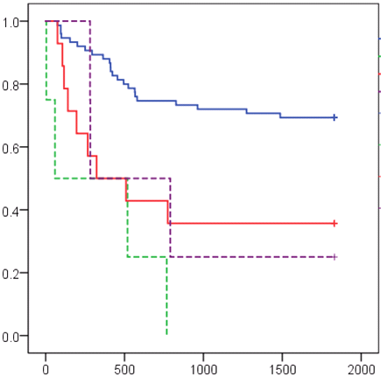
5-year Recurrence-Free Survival by Primary Malignancy
`
Primary Malignancy
Appendiceal 69.3%
Neuroendocrine 0%
Colorectal 39%
Mesothelioma 25%
Overall 58%
Cumulative survival
Variables associated with recurrence:
Received stoma (p:0.04)
Lymph node metastasis (p:0.013)
Received adjuvant chemotherapy (p<0.001)
Time to Recurrence (days)
Notes:
This kaplan-meier demonstrating 5 year recurrence free survival
Overall, 58% of patients did not experience a recurrence
-69% and 39% of patients didn’t develop recurrence in pseudomyxoma and colorectal respectively
-Median time to recurrence was 13 months
-The variables associated with recurrence were:
-If they had a stoma formed, Lymph node metastases and the receipt of adjuvant chemotherapy.
as the associated variables all indicate recurrences more likely in more aggressive histology.
It’s the more aggressive histological disease that develop recurrence as PMP does not commonly cause LN mets, Stoma More aggressive
Adj patients are either incompletely cytoreduced, these do worse and are known to recur sooner
Macri et al. 2010 5 year recurrence free

Slide 15
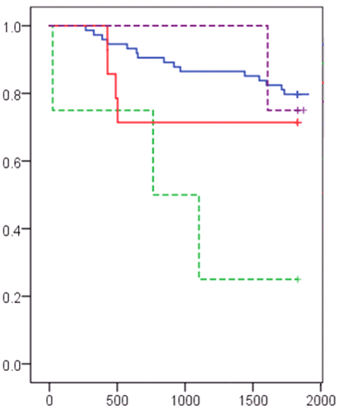
5-Year Survival by Primary Malignancy
`
Primary Malignancy
Appendiceal 81.3%
Mesothelioma 75%
Colorectal 77%
Neuroendocrine 25%
Overall 78%
Cumulative survival
(p <0.05)
Time to death (days)
Notes:
-This is a kaplan-meier graph showing our 5 year survival for all primary malignancies .
-Notably our mucinous appendiceal cancer patients and colorectal cancers patients had 5 year survival of 81.3% ​and 77% respectively. Our cohort’s overall mortality was 78%.
-Of the variables assessed, a CCR score of 1 was associated with overall 5yr mortality

Slide 16
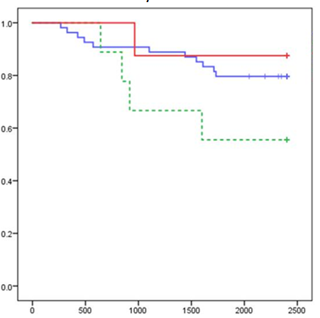
5-Year Survival by PSOGI Classification
`
5 year survival by PSOGI Classification
Acellular | 87.5%
LGMCP | 86%
HGMCP | 67%
HGCMP-S | 33%
Overall | 81.3%
PMP by PSOGI Classification
Acellular
LGMCP
HGMCP
Cumulative survival
(p <0.05)
5 year survival Overall PMP Basingstoke, 2014 | 84%
Time to death (days)
Notes:
Similar to our last graph, this kaplan meier represents 5 year survival for subclasses of pseudomyxoma peritonei.
In keeping with principals of graded atypia, the high grade with signet ring cells have the worst survival outcome at 33% and acellular the best at 87.5%.
This aligns with the international data.
The difference between groups is statistically significant.

Slide 17
Conclusions.
`
Comparable morbidity and perioperative mortality to literature
Comparable recurrence and survival
Improved outcomes with experience
Notes:
To conclude, our data shows that we align with international literature for morbidity, recurrence and mortality.
Our processes have been refined surrounding case selection, technique, equipment, anaesthetics and post-operative care. This has resulted in better outcomes for our patients and highlights the utility of CRS with HIPEC for patients with peritoneal surface malignancy

Slide 18
Acknowledgements.
`
General Surgery Department, Waikato Hospital
Clinical Audit Department, Waikato Hospital
Braemar Hospital
Surgeons on Clarence

